Slide 1
Project 2
AI Boot Camp Project 2
Team Members:
Thomas Brown
Robb Stenman
Jed Murphy

Slide 2
Project Overview
Project Purpose / Description
- Analyze a problem using machine learning (ML):
o Analyze selected Country Exchange Rates and the relationship to their Gross Domestic Product Growth (GDP Growth).

Slide 3
Project Overview
Goal/Questions to be addressed
Goals:
o Analyze Exchange Rates for 10 countries and access correlation to GDP Growth.
o Analyze all 11,762 Exchange Rates for all countries and access correlation to GDP Growth.
o The model demonstrates meaningful predictive power at least 75% classification accuracy or 0.80 R-squared.
Are the exchange rates for a Country a good predictor of annual GDP Growth for that Country?
How closely correlated are exchange rates and GDP Growth for a country?

Slide 4
Overview of data collection, cleanup and exploration process
Data Source for US Treasury Exchange Rate Reporting:
https://fiscaldata.treasury.gov/datasets/treasury-reporting-rates-exchange/treasury-reporting-rates-of-exchange#dataset-properties
Data Source for World Bank Gross National Product:
https://data.worldbank.org/indicator/NY.GDP.MKTP.CD
Project Overview
cleanup

Slide 5
Project Overview
Approach taken to achieve goals
Project Milestones:
Project ideation – Complete 5/27
Data fetching – Complete 5/27
Data exploration – Complete 5/30
Data transformation – Complete 6/3
Data analysis – Complete 6/6
Testing – Complete 6/10
Creating documentation – Complete 6/10
Creating the presentation – Complete 6/10

Slide 6
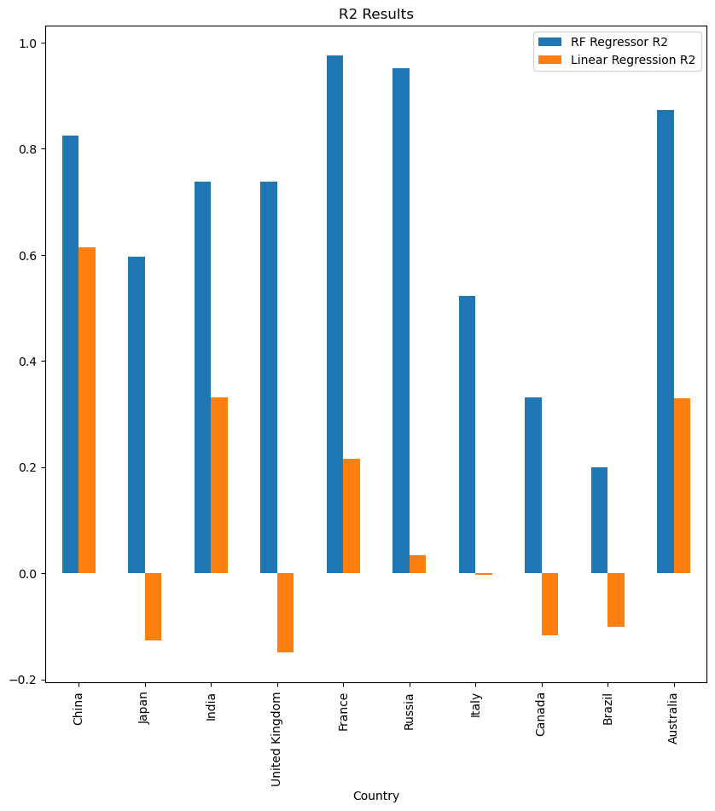
Result/Conclusion

Slide 7
Result/Conclusion
Total of R2 Results using RF Regressor for all Countries taken together was 0.8799472692666176 (see Step3_analyze_data.ipynb).
Country | Ridge MSE | Lasso Regression MSE | Linear Regression R2 | Linear Regression MSE | RF Regressor R2
China | 4.159085752 | 6.123385331 | 0.61371493 | 4.12010746 | 0.824533866
Japan | 8.848326248 | 8.832380251 | -0.127306103 | 8.847658167 | 0.596121356
India | 7.708774877 | 10.53370344 | 0.330875249 | 7.679940508 | 0.737287742
United Kingdom | 15.28339513 | 15.0632336 | -0.149290932 | 15.32888591 | 0.737287742
France | 4.191556172 | 5.357184351 | 0.216185394 | 4.177402261 | 0.975713065
Russia | 19.6133965 | 18.64163694 | 0.033389697 | 19.6250163 | 0.95110876
Italy | 10.77178642 | 10.72117766 | -0.003361944 | 10.79370107 | 0.523217691
Canada | 7.123663353 | 7.236712346 | -0.117751931 | 7.123913001 | 0.331864356
Brazil | 8.047473441 | 8.244038202 | -0.10140481 | 8.109314673 | 0.199654724
Australia | 0.949782473 | 1.446061229 | 0.329694694 | 0.943456912 | 0.873330075
Total for all Countries * |  |  |  |  | 0.879947269
* " Random Forest Regressor" was run over all 11,762 US Treasury Exchange Rates

Slide 8
Result/Conclusion
Provide a summary of the results with the supporting visualizations

Slide 9
First
Summary
Second

Slide 10
Team
Problems Encountered

Slide 11
Summarize any additional questions that surfaced, what your group might research next if more time was available or share a plan for future development.
Team
Future Considerations

